Slide 1
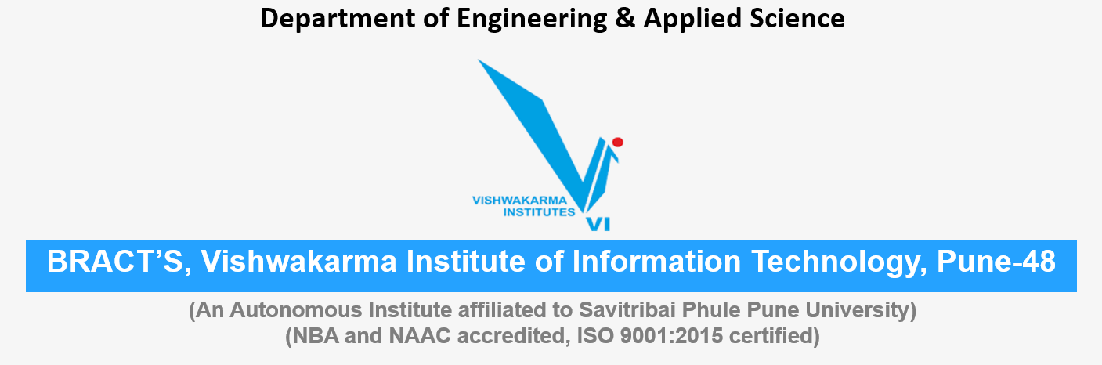
Non-Conventional sources of energy Energy, Water, Environment Sustainability
Roll No. | PRN | Name of student | Div. | VIIT email ID
1405 | 22110075 | Yash Gavit | N | yash.22110075@viit.ac.in
1412 | 22110206 | Prasad Nathe | N | prasad.22110206@viit.ac.in
1418 | 22110305 | Sahil Savardekar | N | sahil.22110350@viit.ac.in
1421 | 22110398 | Siddhesh Khairnar | N | siddhesh.22110398@viit.ac.in

Slide 2



Introduction
What is Energy?:
Energy is one of the most important components of economic infrastructure. In a developing economy, the energy demand is high from sectors like agriculture, industry, residential and economical. Energy resources are very much necessary for the existence of mankind.
Classification of Energy Sources
Energy sources can be divided into two types based on how quickly can they be replenished:
Conventional sources of Energy
Non-conventional sources of Energy
Group 2 , Department of Engineering and Applied Sciences, VIIT, Pune-48

Slide 3
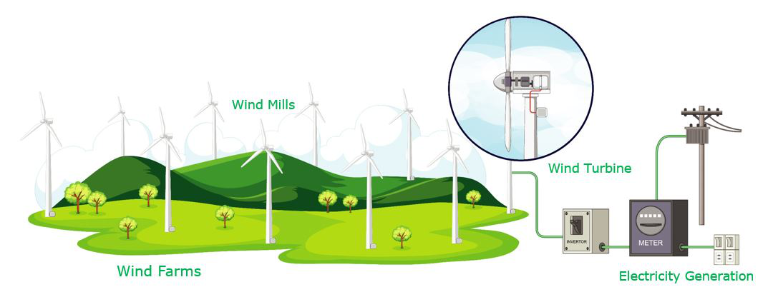
Types of Non-Conventional sources of energy
The most popular renewable energy sources currently are:
Solar energy.
Wind energy.
Hydro energy.
Tidal energy.
Geothermal energy.
Biomass energy.
Group 2 , Department of Engineering and Applied Sciences, VIIT, Pune-48

Slide 4
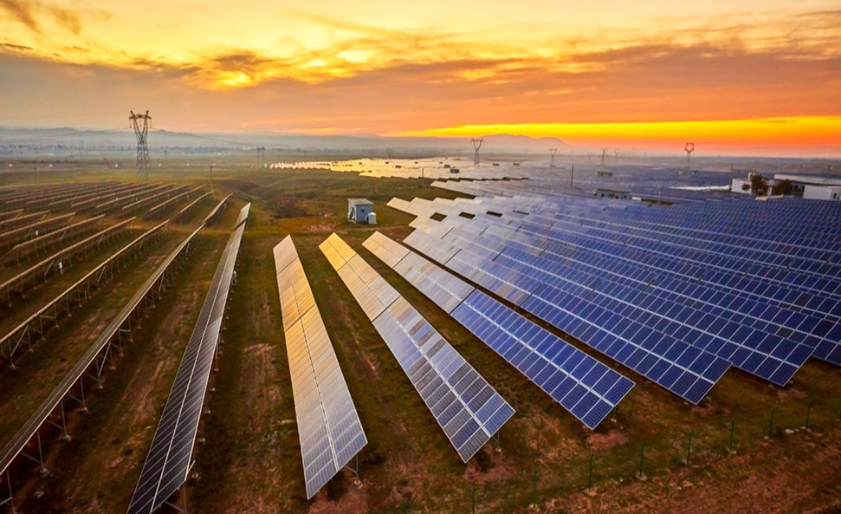

Types of Non-Conventional sources of energy
1.Solar energy
Solar energy is harnessed by converting solar energy directly into electrical energy in solar plants. Photosynthesis process carries out this process of conversion of solar energy. In photosynthesis, green plants absorb solar energy and convert it into chemical energy. Solar energy is an essential energy of all non-conventional sources but its usage amount is very less. It is the most important non-conventional source of energy and it gives non-polluting environment-friendly output and is available in abundant.
2. Wind Energy
Wind energy describes the process by which wind is used to generate electricity. As the wind increases, power output increases up to the maximum output of the particular turbine. Wind farms prefer areas, where winds are stronger and constant. These are generally located at high altitudes. Wind turbines use wind to make electricity. There is no pollution because no fossil fuels are burnt to generate electricity. One of India’s largest windmill farm is in Kanyakumari which generates 380mW of electricity.
Group 2 , Department of Engineering and Applied Sciences, VIIT, Pune-48

Slide 5
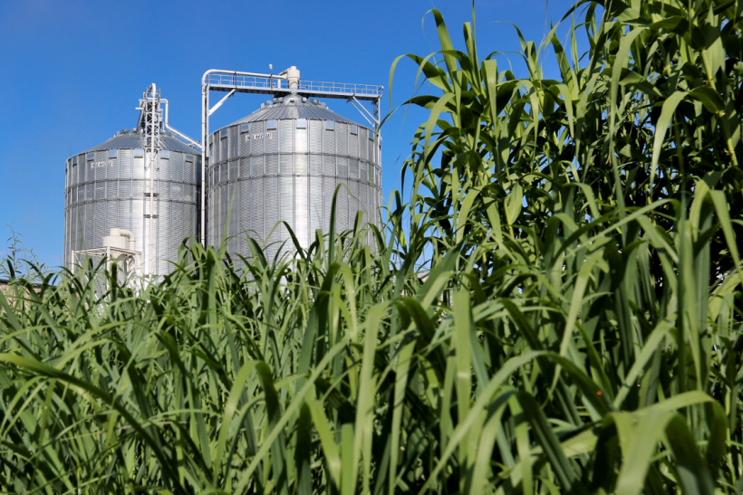
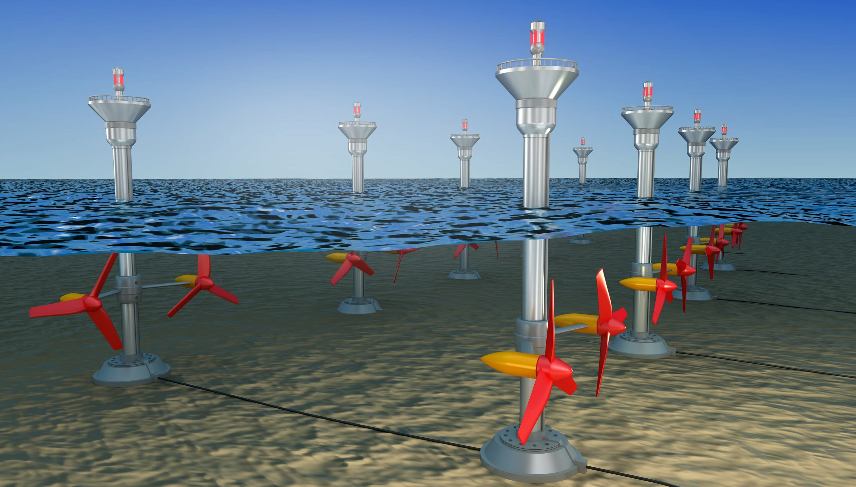
Types of Non-Conventional sources of energy
3.Biomass Energy
Biomass is the organic matter that originates from plants, animals, wood, sewage. These substances burn to produce heat energy which then generates electricity. The chemical composition of biomass varies in different species but generally, biomass consists of 25% of lignin, 75% of carbohydrates or sugar. Biomass energy is also applicable for cooking, lighting, and generation of electricity. The residue left after the removal of biogas is a good source of manure. Biomass is an important energy source contributing to more than 14% of the global energy supply.
4. Tidal Energy
Tidal power is a form of hydropower that converts the energy of tides into electricity. In areas where the sea experiences waves and tides, we can generate electricity using tidal power. India may take up “ocean thermal level conversion” by which it will be able to generate 50,000mW of electricity to meet the power requirements.
Group 2 , Department of Engineering and Applied Sciences, VIIT, Pune-48

Slide 6

Advantages Non-Conventional sources of energy
They are renewable in nature.
They produce little or no pollution as compared to traditional energy sources.
They require little maintenance.
They are a long-term cost-effective choice.
The efficiency of the energy sources is high. ...
The production expenses are low. ...
The raw materials of conventional Sources of Energy are easy to transport. ...
Generally it doesn't need any specific place for installation.
.
Group 2 , Department of Engineering and Applied Sciences, VIIT, Pune-48

Slide 7

Disadvantages Non-Conventional sources of energy
Inconsistent, Unreliable Supply. ...
Pollution. ...
Harmful to Wildlife and Surrounding Environment. ...
High Cost. ...
Not Every Non-Conventional Energy Source Is Commercially Viable. ...
Location-Specificity Means Lower Chances of Universality. ...
Low Efficiency Levels.
Group 2 , Department of Engineering and Applied Sciences, VIIT, Pune-48

Slide 8
Applications Non-Conventional sources of energy
Group 2 , Department of Engineering and Applied Sciences, VIIT, Pune-48

Slide 9
Conclusion
Group 2 , Department of Engineering and Applied Sciences, VIIT, Pune-48

Slide 10
Wrap Up and Conclusion
Group 2 , Department of Engineering and Applied Sciences, VIIT, Pune-48

Slide 11
References and Resources
Group 2 , Department of Engineering and Applied Sciences, VIIT, Pune-48

Slide 12
Thank You
Group 2 , Department of Engineering and Applied Sciences, VIIT, Pune-48
12

